Slide 1
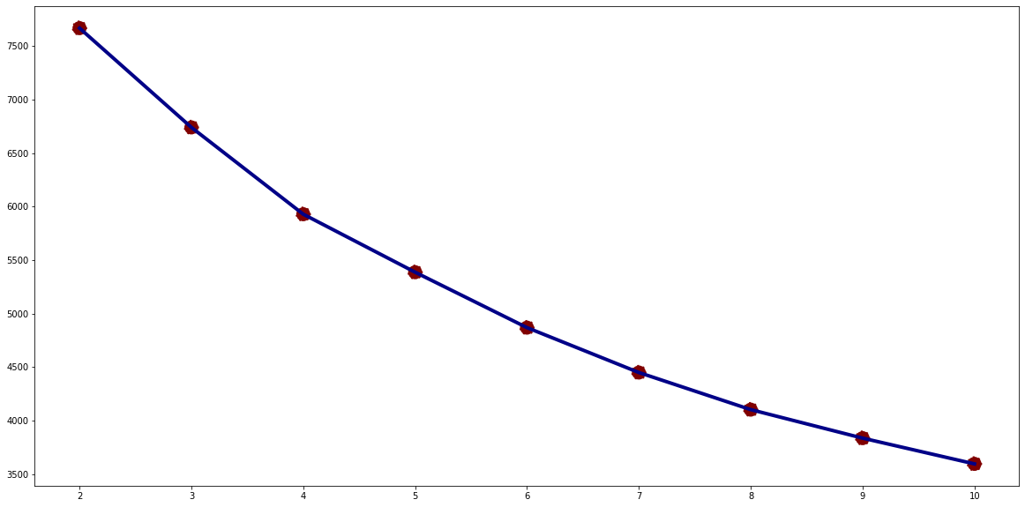
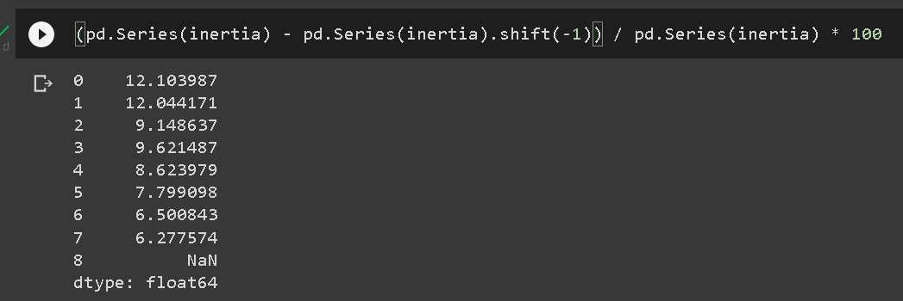
Data Modeling
Based on visualization of the elbow method using k-means clustering, it can be seen that n_clusters = 4 is the optimal number to be used as the number of clusters, when viewed using the inertia score n_clusters = 3 or 4 can be used as the optimal number of clusters.
For more details, see jupyter notebook here

Slide 2
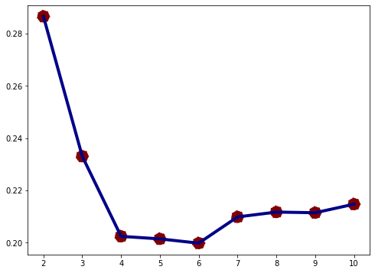
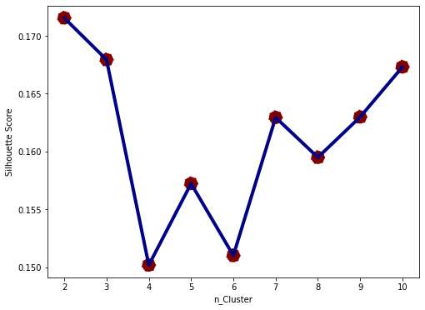
Data Modeling
When evaluated using a silhouette score with 2 metrics, namely euclidean and mahalanobis, it can be seen that the optimal number of clusters is 3 before the silhouette value drops even further. So, for this dataset, 3 clusters are used to interpret customer personality.
For more details, see jupyter notebook here

Slide 3
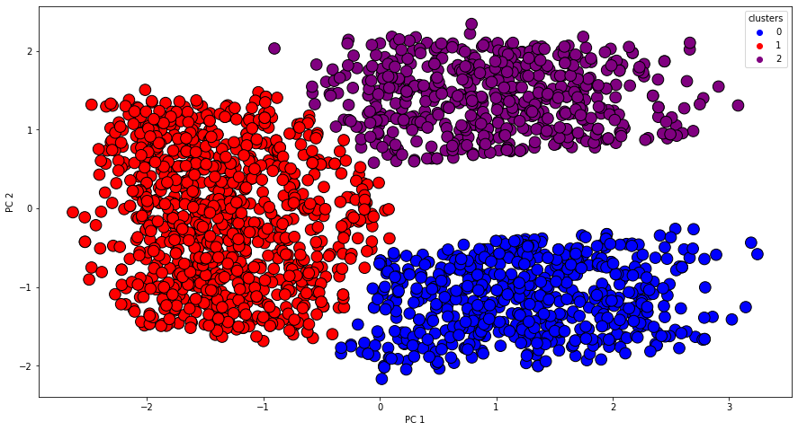
Data Modeling
By using the RFM method to reduce dimensions and using the PCA method to facilitate visualization, it can be seen clearly that there are 3 separated customer clusters generated by the k-means algorithm.
For more details, see jupyter notebook here

